Slide 1


CSC272
Chapters 8-12

Slide 2
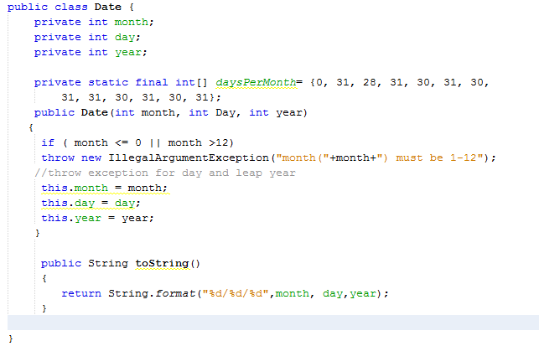
Chapter 8 - Inheritance
Exception handling feature
for validation of input
See page 333 of your textbook

Slide 3
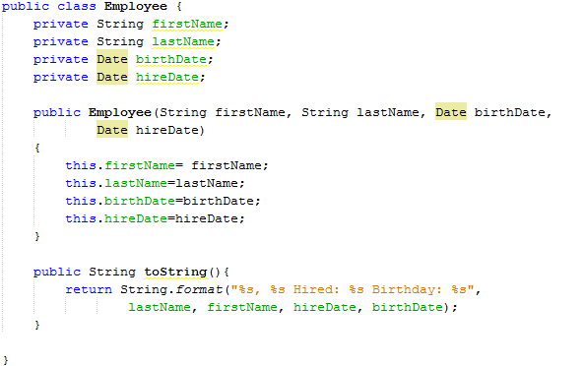
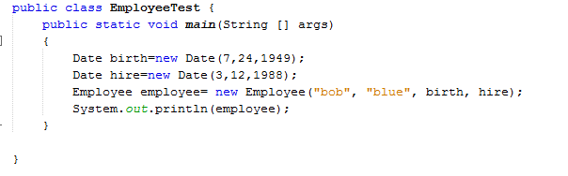
Continued
Date objects, an example of composition
What is printed here?

Slide 4
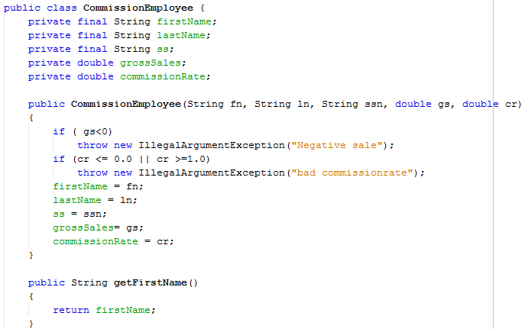
Continued 2

Slide 5
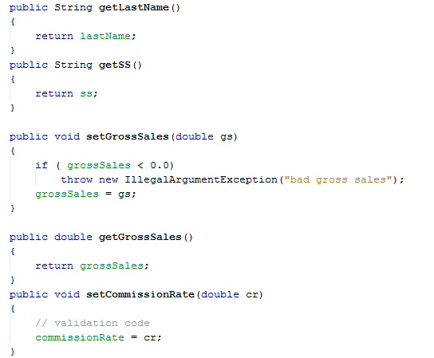
Continued 3

Slide 6
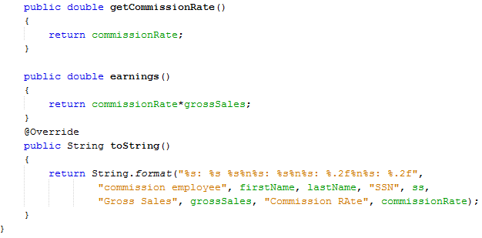
Continued 4

Slide 7
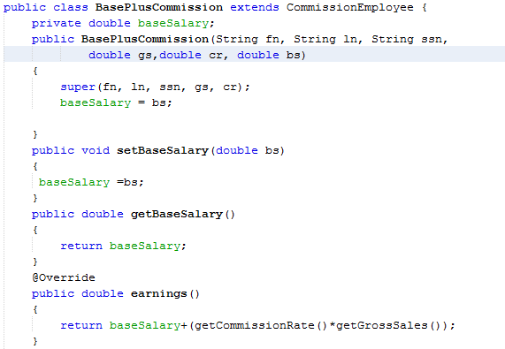
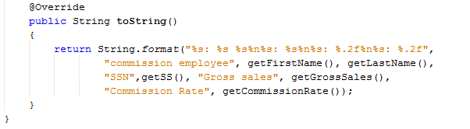
Continued 5
Which class is the Superclass and which one is the subclass?
The extend causes the subclass to inherit Methods and fields of superclass
Subclass does not have direct access to Superclass’s private data members. Need to use get/set methods.
Advantage of Inheritance is code reuse.

Slide 8
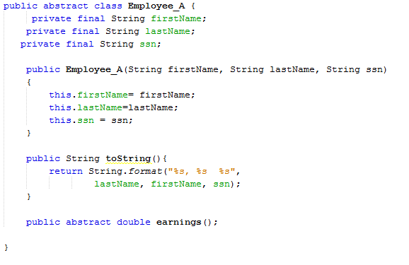
Polymorphism and abstract classes
An abstract class is intended to be used as a super class.
It is an incomplete class and is never instantiated. Subclasses
Define the missing pieces and complete the abstract class, these
are called concrete classes .
Common attributes of classes in the same hierarchy are placed in
The abstract class.
@Override

Slide 9
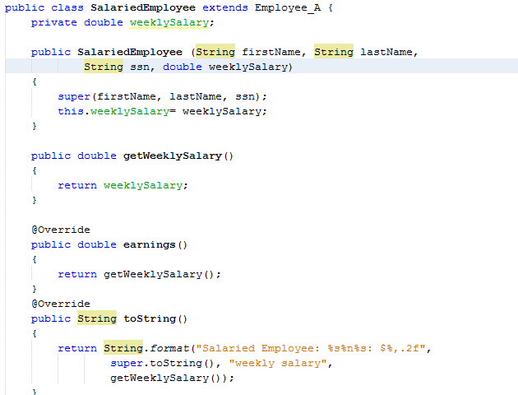
Continued 6
A call to superclass’s constructor.
Provide an implementation for the abstract method earnings

Slide 10
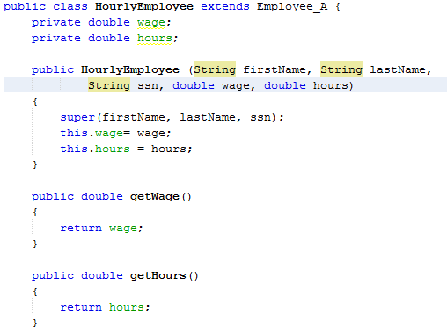
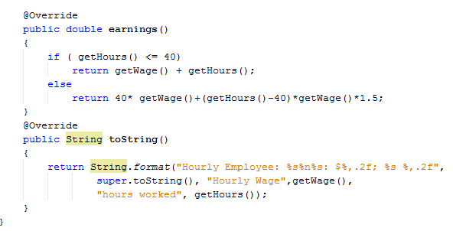
Continued 7

Slide 11
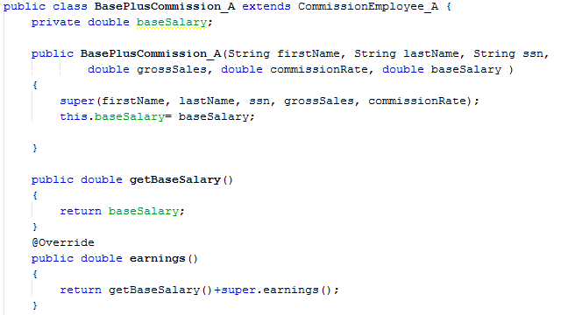
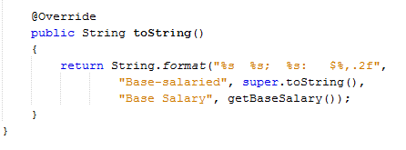
Continued 8

Slide 12
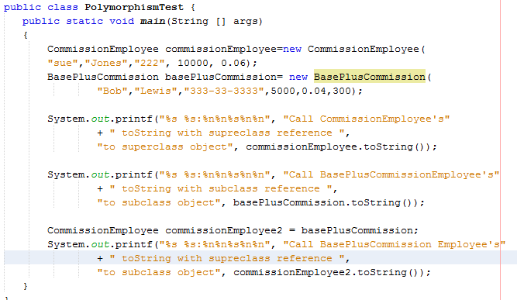
Continued 9

Slide 13
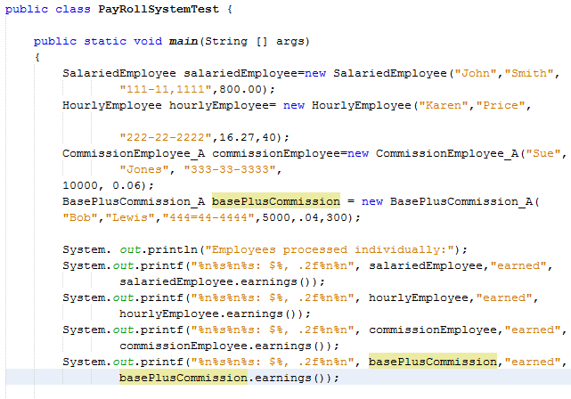
Continued 10

Slide 14
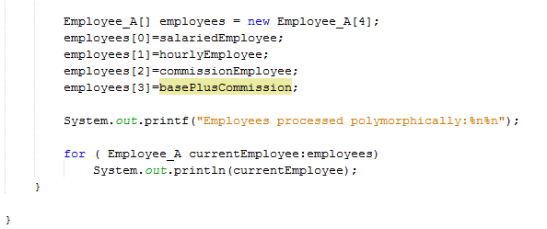
Continued 11

Slide 15
Lab 1 – Student activity
Define the abstract class OneD. This class has one double type instance variable called x.
The class must define set and get methods for the instance variable x. The class must override the method toSting() to display the value of x. Class OneD must also have an abstract method distance().
Define the class TwoD, that inherits from class OneD, class TwoD defines one instance variable called y.
Include the set and get methods for variable y. Override the toString method to display the values of x and y i.e. (x,y). Class TwoD must also override the distance function to return the distance of point (x,y) from the origin. Ask your instructor for the formula if you have forgotten it.
Define class ThreeD, this class inherits from class TwoD and introduces a new instance variable called z.
Define set and get methods for variable z. override toString() method to display (x,y,z). Override method distance() to return the distance of (x,y,z) from the origin. Ask your instructor for the formula.
Write a main function to test your classes.

Slide 16

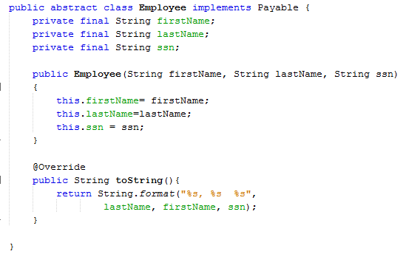
Interfaces
Abstract class
Implements the Payable interface
Subclasses must implement the methods
In interface Payable.

Slide 17
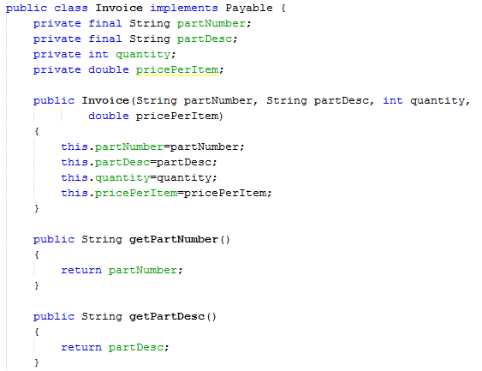
Continued 12

Slide 18
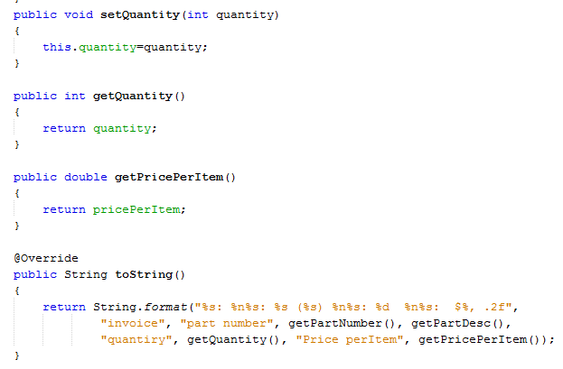
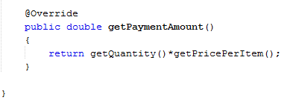
Continued 13

Slide 19
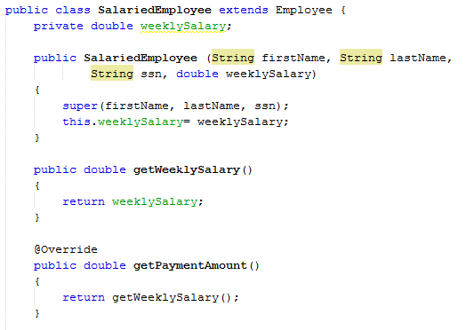
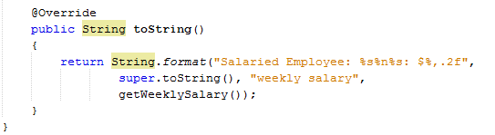
Continued 14

Slide 20
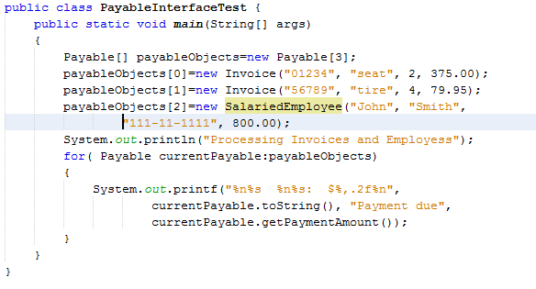
Continued 15

